Slide 1
THE FATHER, SON, & HOLY SPIRIT
THE HOLY SPIRIT IN CONVICTION AND CONVERSION

Slide 2
Common Views
“The Holy Spirit is God’s present activity in our midst. When we sense God’s leading, God’s challenge, or God’s support or comfort, we say that it’s the Holy Spirit at work.” (www.umc.org)
“We believe the Scriptures teach that in order to be saved, men must be regenerated, or born again; that regeneration consists in giving a holy disposition to the mind; that it is effected in a manner above our comprehension by the Holy Spirit.”
(Edward T. Hiscox, The Standard Manual For Baptist Churches)

Slide 3
Common Views
“It is the Spirit who brings conviction to the unbeliever and causes him to see the truth of the gospel in a clear light…The Holy Spirit controls the believer who yields to God and submits himself to God’s Word.”
(www.moodyglobal.org)
“As the Spirit within opens up new insights when I hold the sacred book in my hand and read it, I am drawn ever closer to him who left heaven to become closer to me.”
(W. Carl Ketcherside, Mission Messenger)

Slide 4
Common Views
“…the gospel invitation…will not bring sinners to Christ…the Holy Spirit performs a work of grace within the sinner which inevitably brings him to faith in Christ…The Spirit creates within him a new heart or new nature…The Spirit in no way is dependent upon their help or cooperation for success in His work of bringing them to Christ.”
(Steele, Thomas, The Five Points of Calvinism: Defined, Defended, Documented, pp. 48. 49)

Slide 5
God’s Plan
The Plan Conceived
Before Time Began
2ND TIM. 1:9; 1ST PET. 1:18-20
Hidden For A Time
EPHESIANS 3:5

Slide 6
God’s Plan
The Plan Executed
God Sent A Savior
JOHN 3:16
He Died For Our Sins
1ST COR. 15:3; 1ST JOHN 3:5

Slide 7
God’s Plan
The Plan Revealed
To The Apostles
EPH. 3:5; 1ST COR. 2:10, 12
Spoken And Written
TITUS 1:3; MARK 16:15, 16; EPH. 3:4; 1ST COR. 2:13

Slide 8
The Holy Spirit in Conviction
What Convicts?
HEB. 11:1
“God grants faith, a faith that will infallibly arise in the heart of those He has given His Son...If a person becomes humble enough to submit to God it is because the Holy Spirit has given that person a new, humble nature...not because some men are more humble than others…While God requires faith of all men He promises to give unto all those that are ordained unto eternal life his Holy Spirit, which quickens and disarms hostility so they are willing, and able to believe.” (www.reformationtheology.com)

Slide 9
The Holy Spirit in Conviction
What Convicts?
What Is Written
JOHN 20:30, 31
Faith → Hearing → Word
ROM. 10:17

Slide 10
The Holy Spirit in Conviction
Convicted Hearers
On Pentecost
ACTS 2:37-41
With Stephen And the Apostles
ACTS 5:30, 31; 7:52-58

Slide 11
The Holy Spirit in Conviction
The Holy Spirit’s Part
NOT A Direct Operation On Lost Souls
ACTS 16:14; 8:5-17
But By The Word Spoken

Slide 12
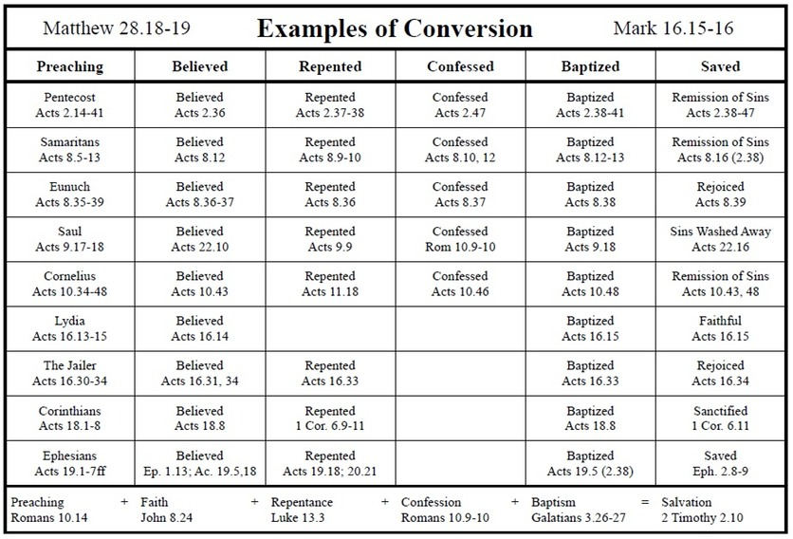

Slide 13
The Holy Spirit in Conversion
Repentance Because of Conviction
Absolutely Necessary
ACTS 17:30; 2ND PET. 3:9; ACTS 2:38; 3:19; 26:20
A Required Action
EPH. 4:17-24

Slide 14
The Holy Spirit in Conversion
Converted Individuals
The Corinthians
1ST COR. 6:9-11; 15:1, 2; ACTS 18:8
The Romans
ROM. 6:17-19

Slide 15
The Holy Spirit in Conversion
The Holy Spirit’s Part
Sending Men To Preach the Word
EPH. 3:5;1ST COR. 2:10, 12; ACTS 8:29ff
Miracles, Signs, Wonders As Proof
ACTS 1:8; MARK 16:20; HEB. 2:1-4

